Slide 1

CHAPTER 6
Mechanical Properties
of
Metals - I

Slide 2
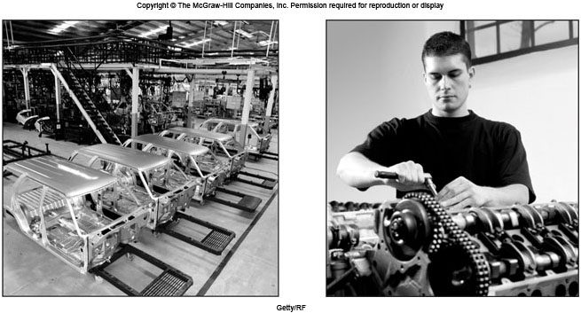
Manufacturing of Automobile Parts
沖壓
Body panels are stamped from steel sheets and are then spot-welded together (Left). Complex and nonsymmetrical parts such as bevel gear or universal joints are forged almost ready to install (Right).
Processing → Stress & Strain → Hardness → Plastic Deformation → Solid-solution Strengthening → Annealing → Superplasticity
錐齒輪

Slide 3
Processing of Metals - Casting
Most metals are first Melted in a furnace → Alloying is done if required (e.g. Al + Mg) → Degassing and De-slag → Large sheet ingots or extrusion ingots (billets) are then Cast.
Slab, plates, sheets and bars are then produced from ingots by Rolling軋延. 扁坯、厚板、薄板
Channels and structural shapes are produced by Extrusion.
Wrought alloy 鍛造合金 products: via hot and cold work processes.
Some small parts can be cast as final product. Only a small amount of machining or other finishing operation is required.
Cast Products and Casting Alloys. Example: Automobile Piston.

Slide 4
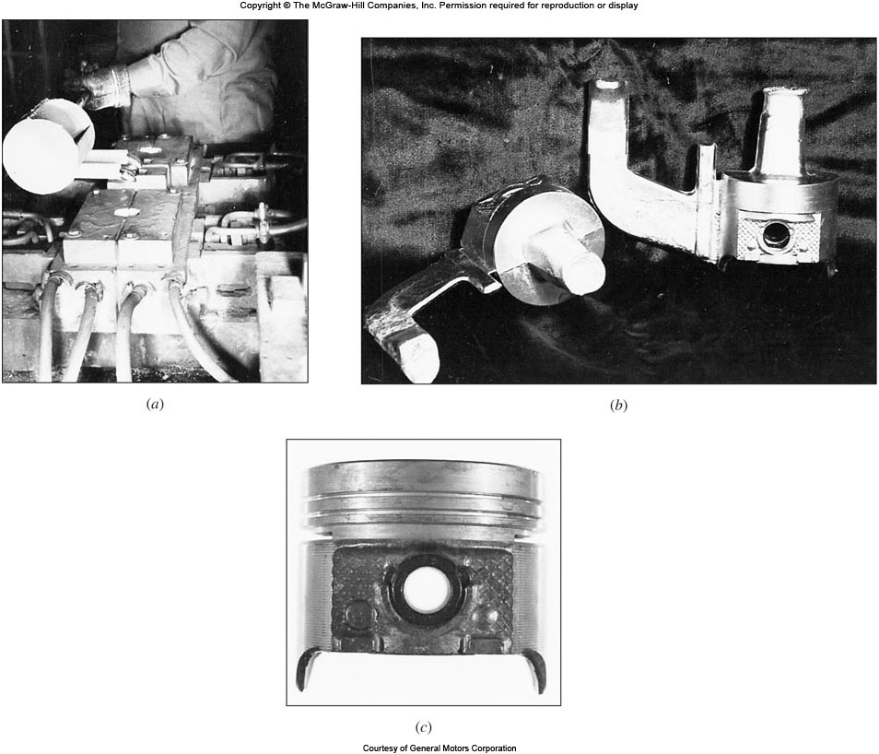
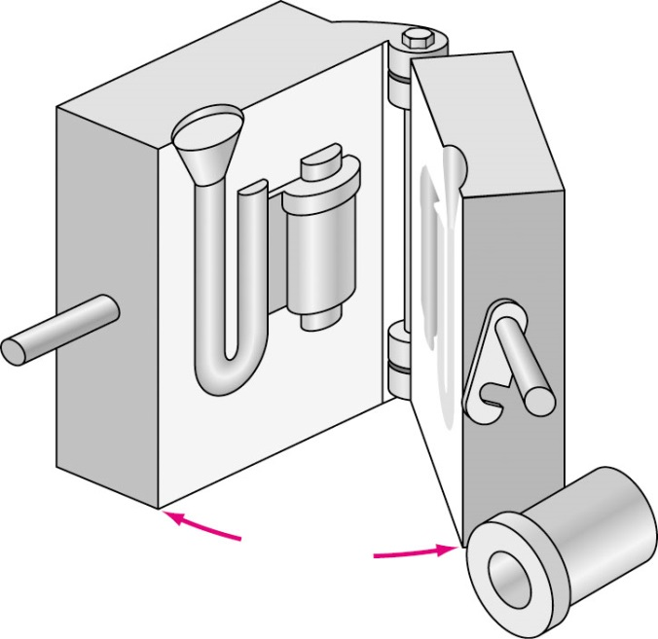
Permanent Mold Casting of Al-Pistons
Casting Process and Castings
Finished Piston
Casting mold

Slide 5
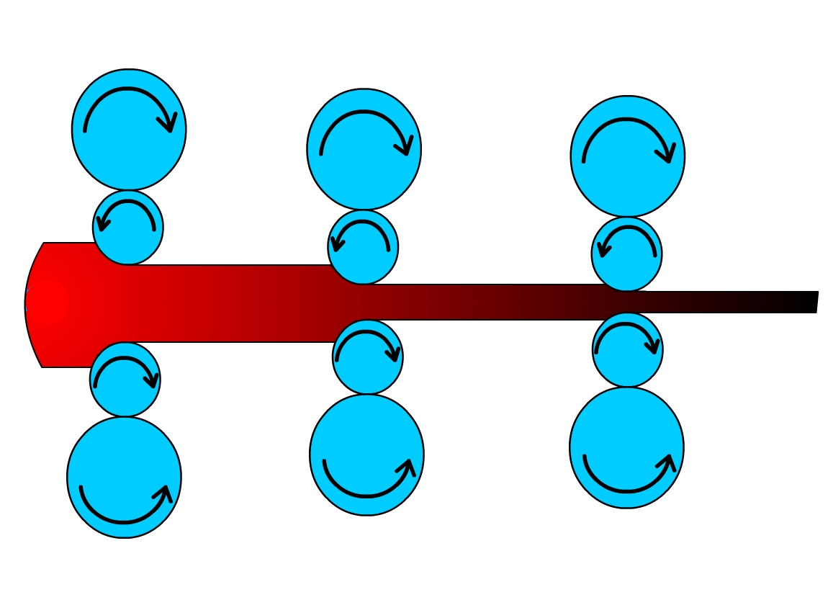
Hot Rolling of Steel
Hot rolling Greater reduction of thickness in a single pass.
Rolling carried out at above recrystallization temperature.
Ingots preheated to about 1200 °C.
Ingots reheated between passes required.
Usually, series of 4 high rolling mills are used.
再結晶
輥輪

Slide 6
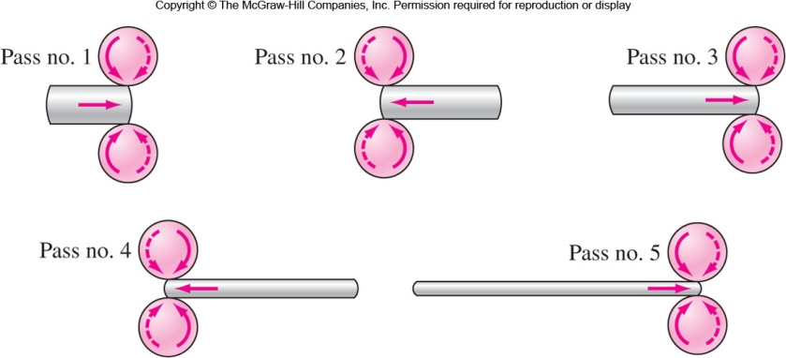
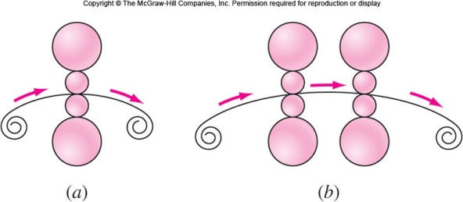
Hot Rolling and Cold Rolling
Reducing ingot to a slab (扁鋼胚) on a reversing two-high mill (二輥軋機)
Cold rolling of metal sheet by four-high mills:
Single mill (單站軋機)
Two mills in series. (雙站軋機)

Slide 7
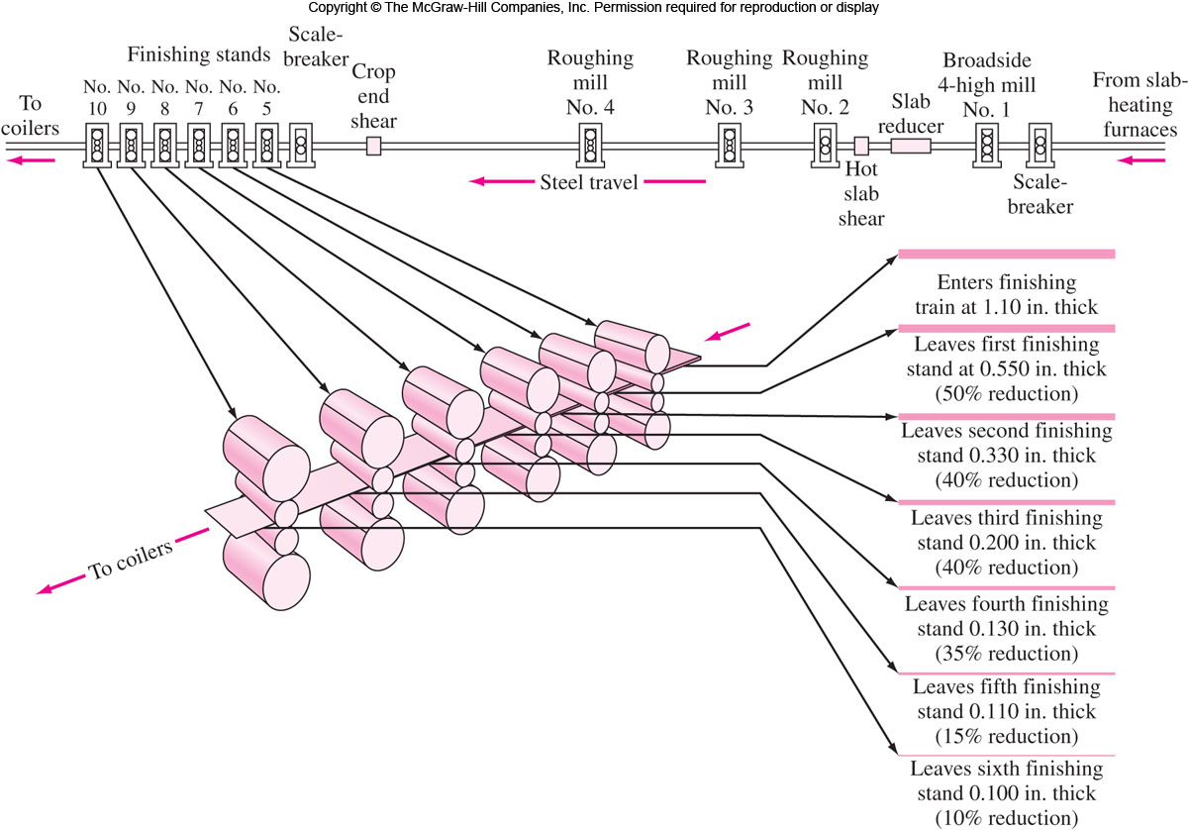
Hot Rolling of Steel Strip
Typical reductions per pass in the finishing stands of hot-strip (熱軋鋼帶) mill equipped with four roughing (粗軋) stands and six finishing (精軋) stands.

Slide 8
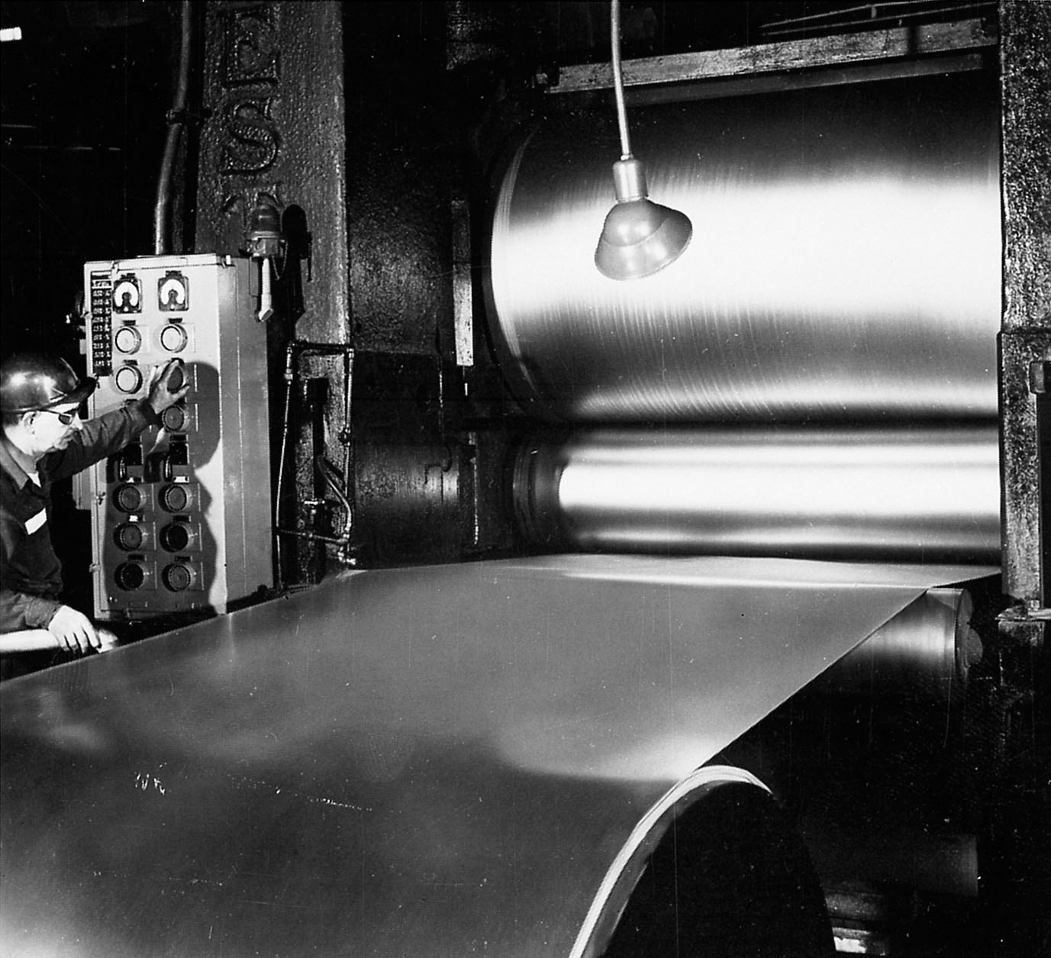
Cold Rolling of Metal Sheet
Cold rolling is rolling performed below recrystallization temperature.
This results in strain hardening.
Hot rolled slabs have to be annealed before cold rolling.
Series of 4 high rolling mills are usually used.
Less reduction of thickness.
Needs high power.
Good appearance.
Initial metal thickness – Final metal thickness
% Cold work =
× 100
Initial metal thickness

Slide 9
Calculate the Percent Cold Work
EP 6.2 A sheet of a 70% Cu-30%Zn alloy is cold-rolled 20 percent to a thickness of 3.00 mm. The sheet is then further cold-rolled to 2.00 mm. What is the total percent cold work?
Let x equal the starting thickness of this sheet. Then
The total percent cold work from the starting thickness to the finishing thickness is

Slide 10
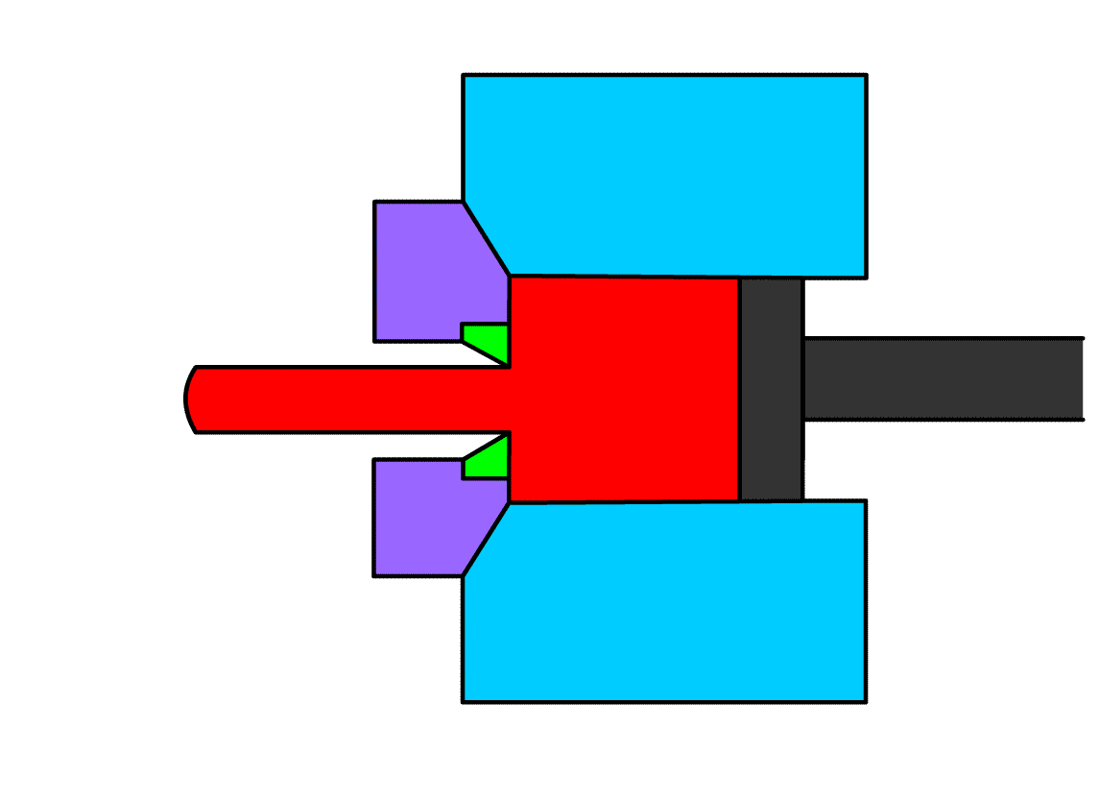
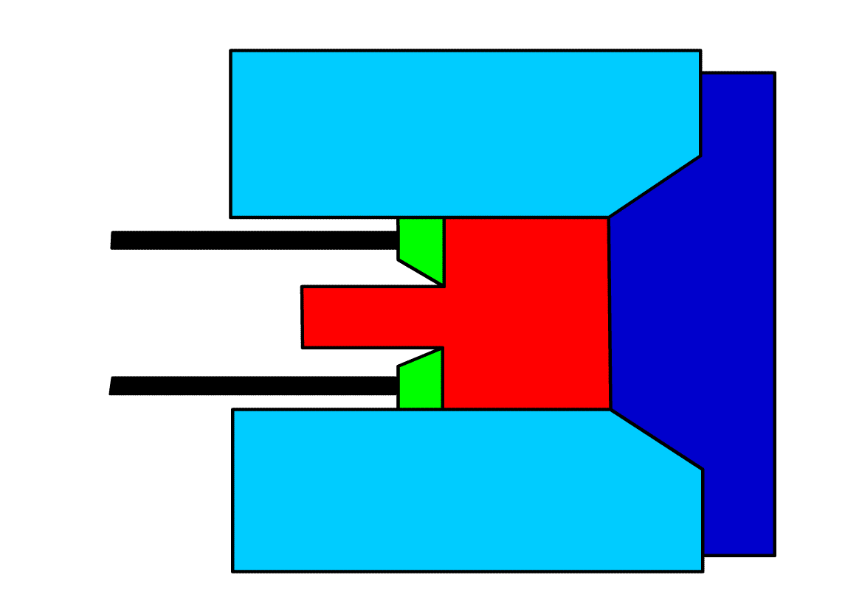
Extrusion 擠型
Metal under high pressure is forced through opening in a die.
Common Products are cylindrical bars, hollow tubes, irregular shapes from aluminum, copper, even some carbon and stainless steels.
Normally done at high temperature.
Direct extrusion vs. Indirect extrusion.
Indirect extrusion needs less power however has limit on load applied.
Die
Container
Metal
Ram
Direct
Extrusion
Ram
Container
Metal
Ram
Indirect Extrusion

Slide 11
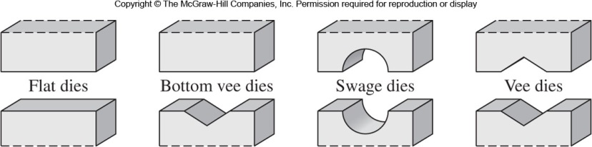
Forging 鍛造
Metal, usually hot, is hammered or pressed into desired shape. Hammer Forging 錘鍛 vs. Press Forging 壓鍛
Open die: Dies are flat or simple in shape. Example products: Large steel shafts for electric steam turbines and generators..
Closed die: Dies have upper and lower impressions. Example products: Automobile engine connection rod.

Slide 12
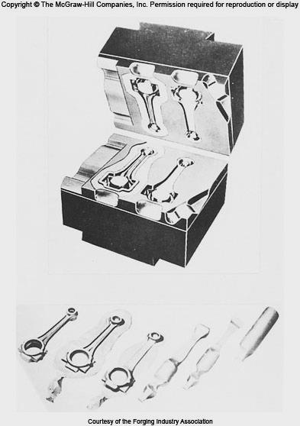
Forging (Cont…)
Forging increases structural properties, removes porosity and increases homogeneity. Example: A forged wrench will be tougher and less likely to break down than cast one.
Breaking down the as-cast ingot structure and getting more homogeneous, metal is less likely to crack during subsequent working.

Slide 13
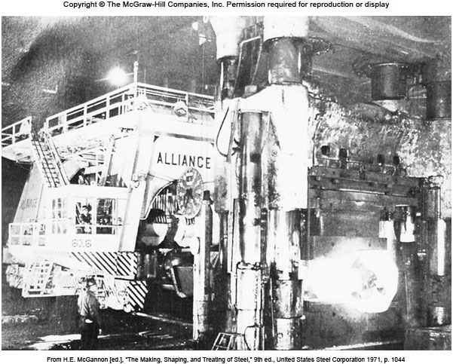
10,000-ton Press for Steel Forging

Slide 14
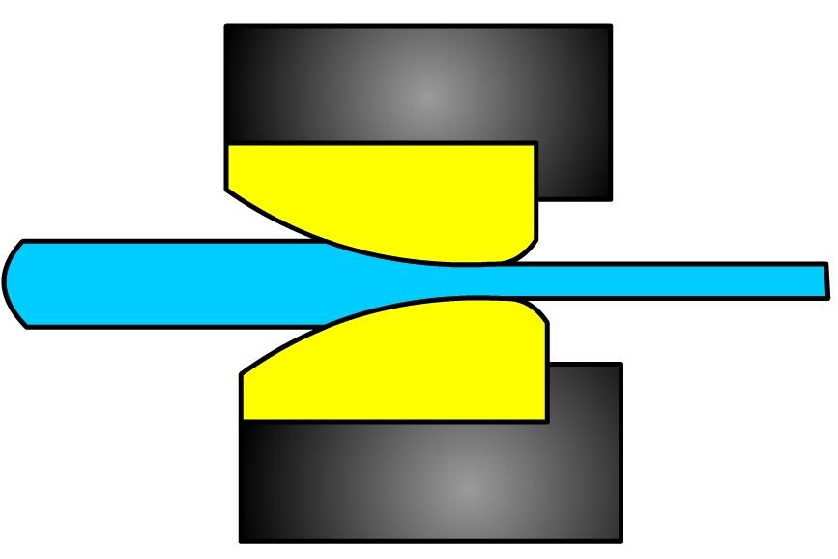
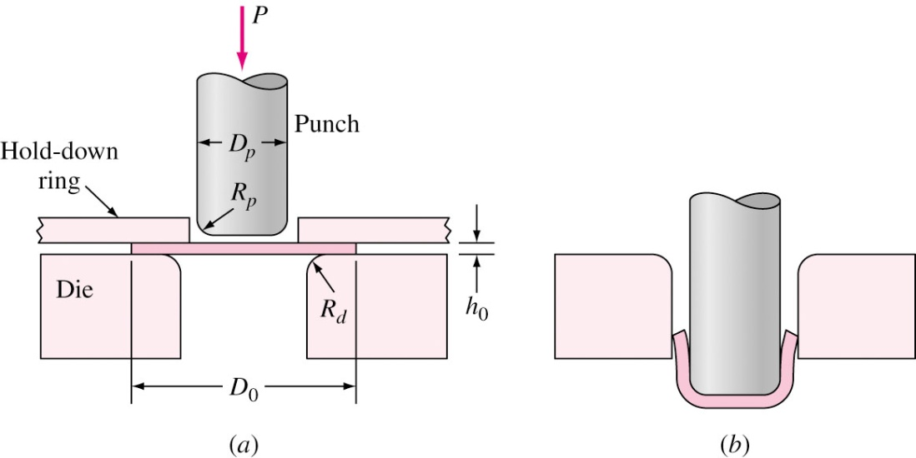
Drawing 抽線
Wire drawing: Starting rod or wire is drawn through several drawing dies to reduce diameter.
Precautions: Clean, Lubrication, Softening heat treatment.
Deep drawing: Used to shape cup like articles from flats and sheets of metals.
% cold work =
Change in cross-sectional area
× 100
Original area
Wire or rod
Carbide nib
眼模
深衝

Slide 15
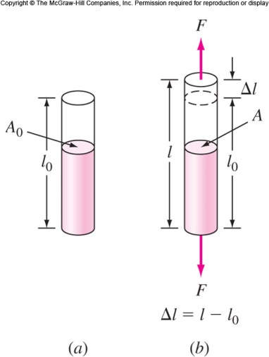
Stress and Strain in Metals
Metals undergo deformation under uniaxial tensile force.
Elastic deformation: Metal returns to its original dimen-sion after tensile force is removed. Atoms are displaced but not to take new positions and return to original positions when force is removed.
Plastic deformation: The metal is deformed such an extent that it cannot return to its original dimension. Atoms are permanently displaced. Such as the extensive plastic deformability of steel.
Elastic deformation

Slide 16
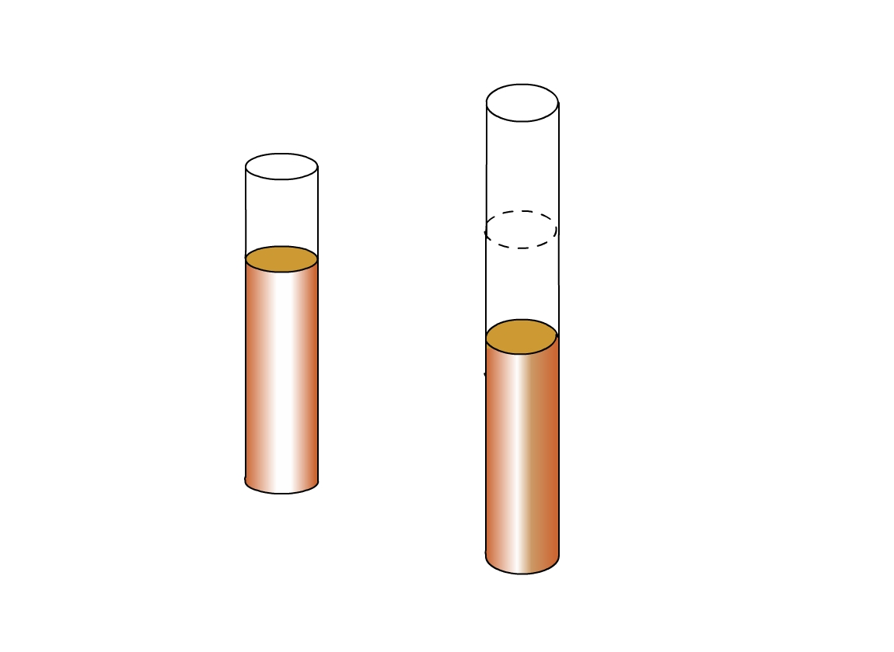
Engineering Stress and Strain
F (Average uniaxial tensile force)
Engineering stress σ =
A₀ (Original cross-sectional area)
Units of stress: psi (lb_{f}/in.²) or Pa (N/m², Pascals)
A₀
Δl
1 psi = 6.89 × 10³ Pa 10⁶ Pa = 1 MPa = 10.204 atm 1000 psi = 1 ksi = 6.89 MPa 1 kgf/mm² = 9.8 N/mm² = 9.8 MPa
A
Engineering strain ε =
Change in length
Original length
Gage Length: 51 mm
Units of strain are in/in or m/m
% engineering strain = engineering strain × 100% = % elongation

Slide 17
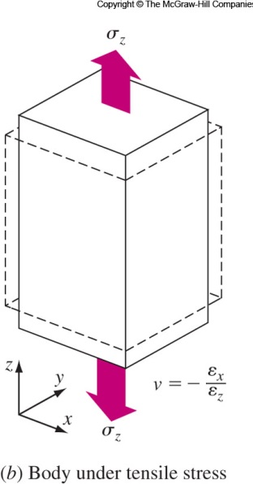
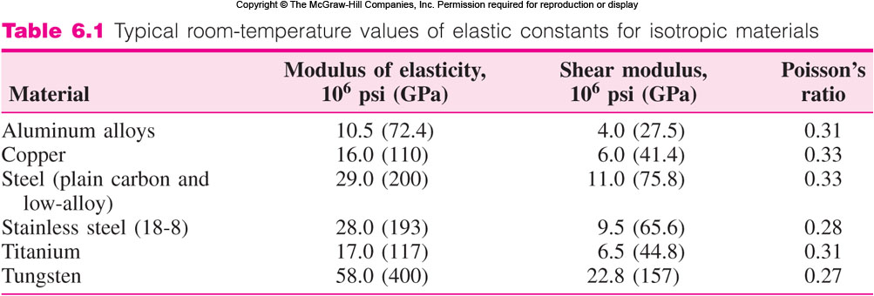
Poisson’s Ratio
ν: Poisson’s ratio 波益松比值 Ideal materials: 0.5
Real materials: 0.25 to 0.4, (0.3).

Slide 18
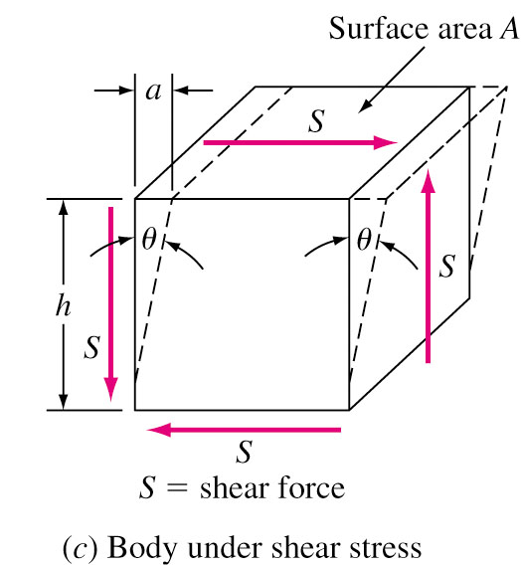
Shear Stress and Shear Strain
S (Shear force)
Shear stress τ =
(Pa, psi)
A (Area of shear force application)
Amount of shear displacement a
Shear strain γ =
= tan θ
Distance over which shear acts h
Shear Modulus G = τ / γ
Shear Modulus G 剪模數
~ 0.35-0.40 Elastic Modulus E

Slide 19
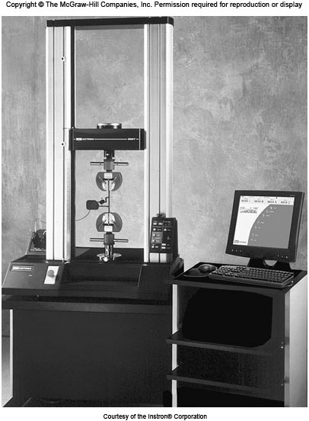
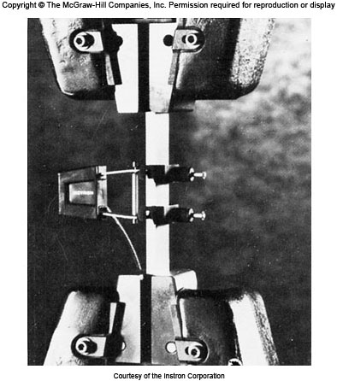
Tensile Test
Strain data is obtained from Extensometer.

Slide 20
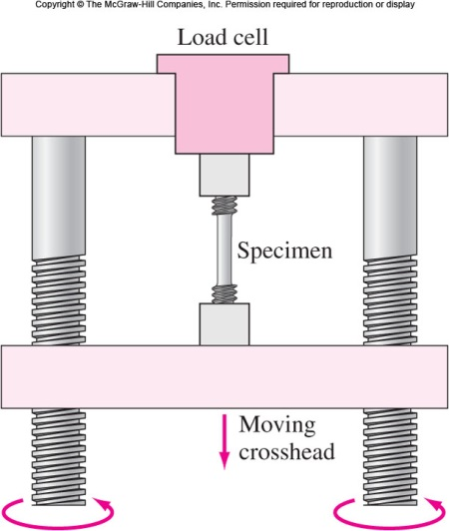
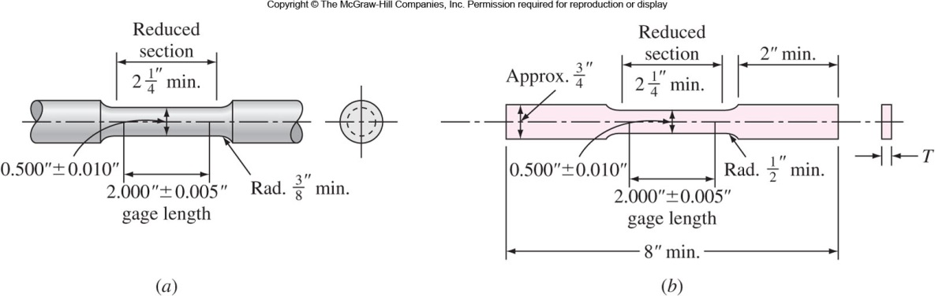
Tensile Test (Cont…)
標距
Standard round 5.08 cm specimen
Force data is obtained from Load cell.
Standard rectangular 5.08 cm specimen

Slide 21
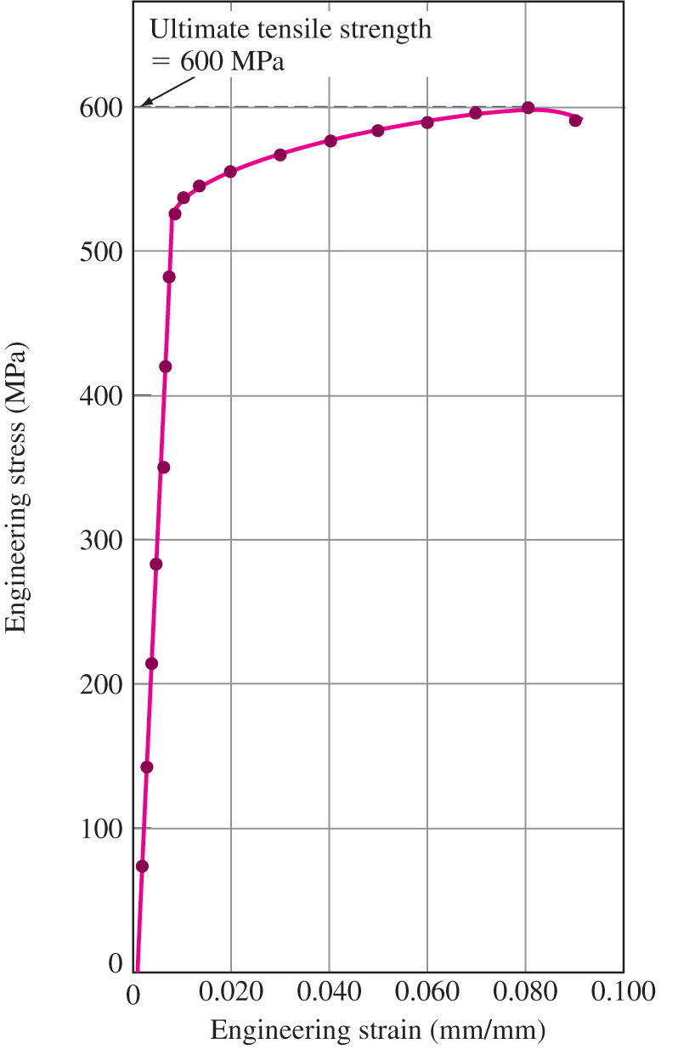
Tensile Test (Cont)
Tensile Test (Cont…)
Strength of materials can be tested by pulling the metal to failure.
Force data is obtained from Load cell. 荷重元
Strain data is obtained from Extensometer. 伸長計
The force data can be converted to engineering stress and the plot of engineering stress versus engineering strain can be constructed.
UTS
YS
E
Engineering stress-strain curve of Al 7075-T6
% elon.
21

Slide 22
Modulus of Elasticity 彈性模數
Modulus of elasticity (E, or Young’s Modulus): Stress and strain are linearly related in elastic region. (Hooke’s law)
σ = E ε or
Higher the bonding strength, higher is the modulus of elasticity.
σ (Stress)
Δσ
E =
E =
Stress
Δσ
Δε
ε (Strain)
Δε
Strain
Linear portion of the
stress strain curve
E_{steel} = 207 GPa.
E_{Aluminum} = 69-76 GPa
•Modulus does not change with increasing stress.

Slide 23
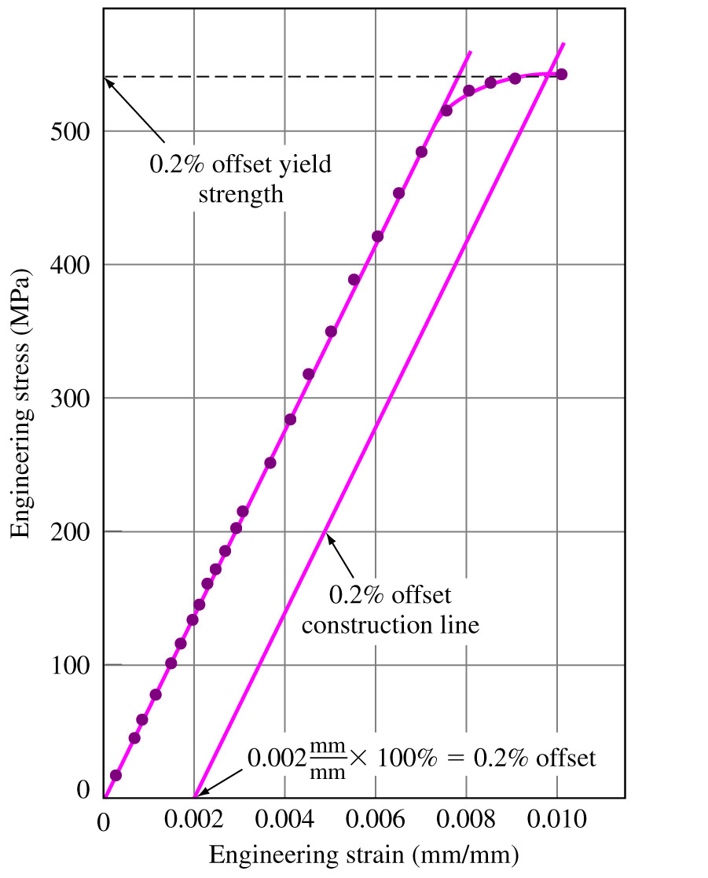
Yield Strength 降伏強度
Yield strength is strength at metal or alloy show significant amount of plastic deformation.
YS is very importance for engineering design.
0.2% offset yield strength is that strength at which 0.2% plastic deformation takes place.
Construction line, starting at 0.2% strain and parallel to elastic region is drawn to 0.2% offset yield strength.
0.1% offset yield strength is commonly used in the United Kingdom.
537 MPa
偏位降伏強度
23

Slide 24
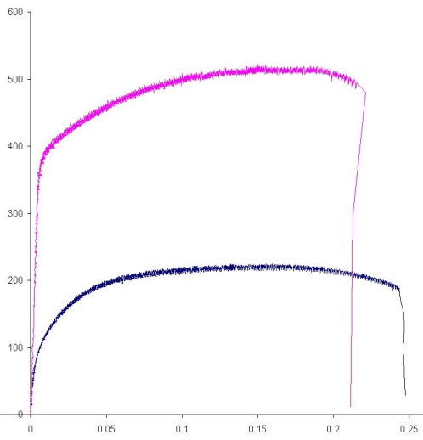
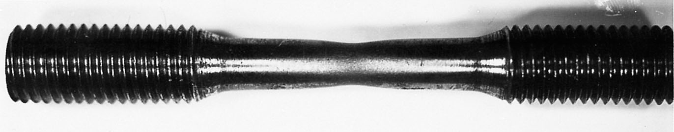
Ultimate tensile strength
Ultimate Tensile Strength 抗拉強度
Ultimate tensile strength (UTS) is the maximum strength reached by the engineering stress strain curve.
Necking starts after UTS is reached.
More ductile the metal is, more is the necking before failure.
Stress increases till failure. Drop in stress strain curve is due to stress calculation based on original area.
UTS is not used much in design. It can indicate the presence of defects and the tolerance before fracture.
UTS =
600 MPa
頸縮
Al 2024-Tempered
Necking Point
Al 2024-Annealed
Engineering stress-strain curve of Al 7075-T6

Slide 25
Percent Elongation
Percent elongation is a measure of ductility of a material.
It is the elongation of the metal before fracture expressed as percentage of original length.
Measured using an extensometer or a caliper fitting the fractured metal together (gage marker).
Example: Percent elongation of pure aluminum is 35%. For 7076-T6 aluminum alloy, it is 11%.
Low percent elongation may indicate the presence of porosities, inclusions, or overheating damage.
Final length – Initial length
% Elongation =
× 100%
Initial length
25

Slide 26
Percent Reduction in Area
Percent reduction in area is also a measure of ductility.
The diameter (in general, r₀ = 12.7 mm) of fractured end of specimen is measured using caliper.
Percent reduction in area in metals decreases in case of presence of porosity.
Example: 12.7 mm dia. → 8.7 mm dia.
Final area – Initial area
% Elongation =
× 100%
Initial area
26

Slide 27
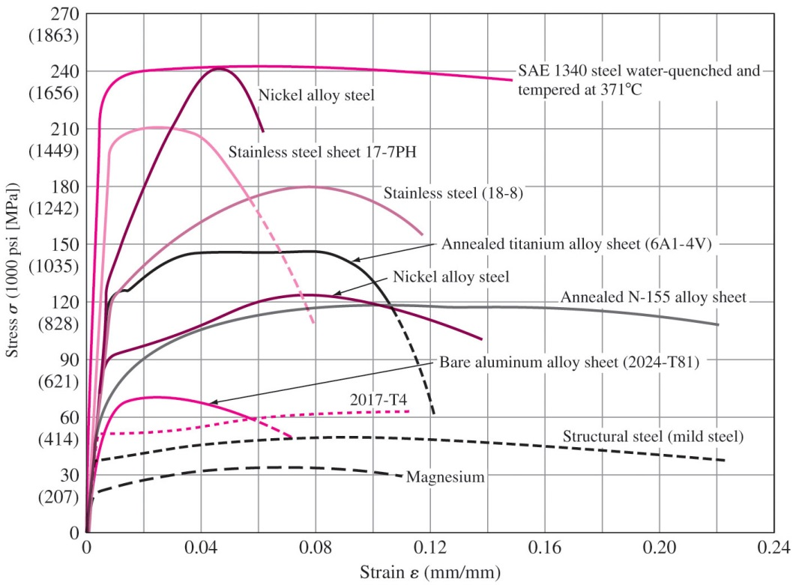
Engineering Stress-Strain Curves
1654 MPa
Maraging Steel
241 MPa

Slide 28
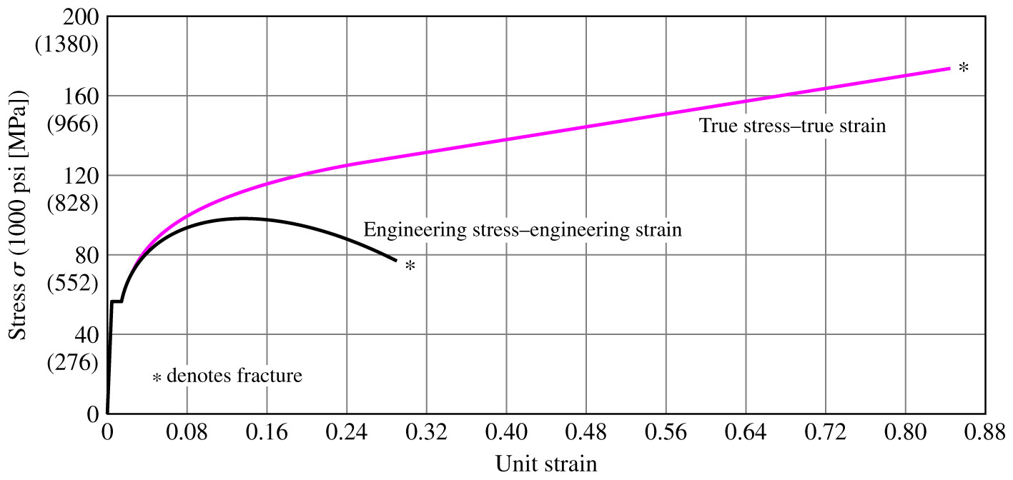
True Stress – True Strain
True stress and true strain are based upon instantaneous cross-sectional area and length.
True Stress = σ_{t} =
True Strain = ε_{t} =
True stress is always greater than engineering stress. True stress-strain curves are used for research.
Low-carbon steel
F
A_{i} (instantaneous area)
28

Slide 29
EP 6.8 Compare the engineering stress and strain with the true stress and strain for the tensile test of a low-carbon steel. Load: 69,000 N, Instantaneous diameter (69,000 N): 1.20 cm, Initial diameter: 1.27 cm.

Slide 30
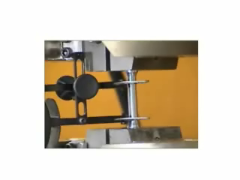
Tensile Test – 1018 Steel (Low Carbon)
Tensile strength = 440 MPa, Modulus of Elasticity = 205 GPa
Reduction in area = 40%, Elongation = 15%
30

Slide 31
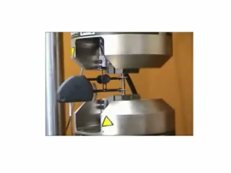
Tensile Test 1045 Steel (Medium Carbon)
Tensile Strength = 696 MPa, Elastic Modulus = 207 GPa
Area reduction = 40%, Elongation = 10%
31

Slide 32
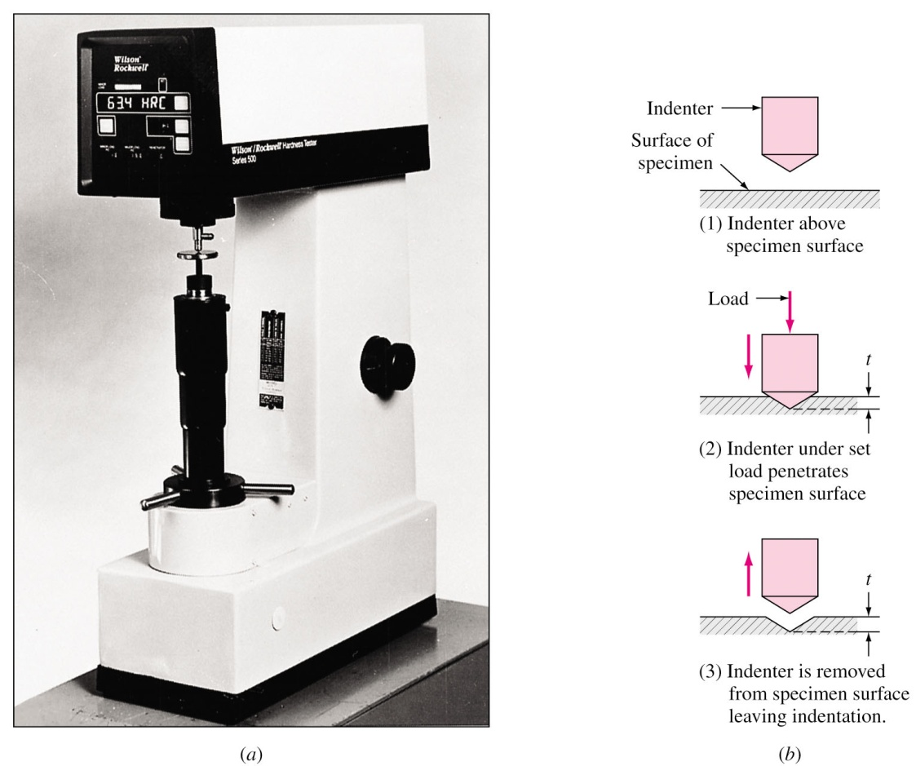
Hardness and Hardness Testing
Hardness is a measure of the resistance of a metal to permanent (plastic) deformation.
General procedure:
Press the indenter that
is harder than the metal
into metal surface
Withdraw the indenter
Measure hardness by
measuring depth or
width of indentation
Rockwell hardness tester

Slide 33
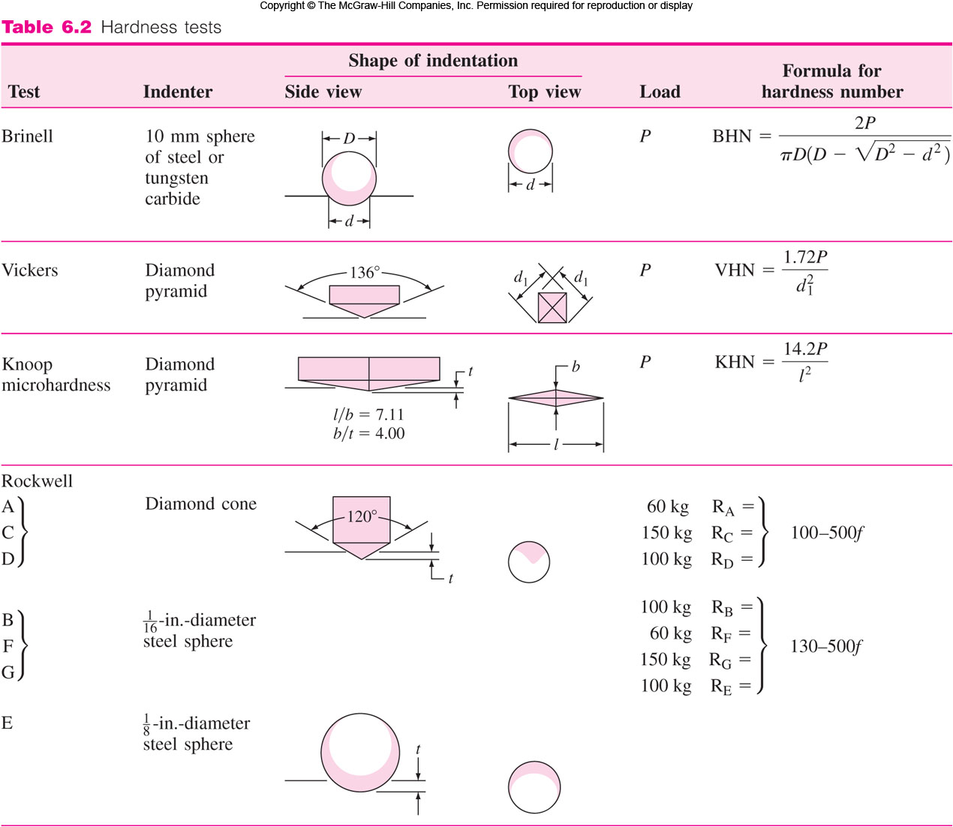
Hardness Tests

Slide 34
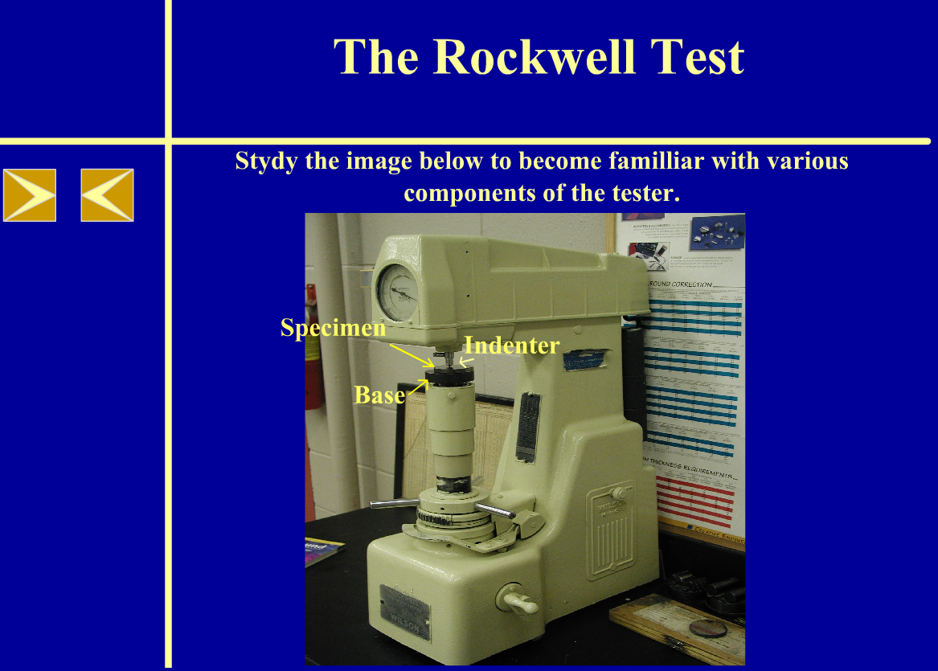
Hardness: Virtual Lab Module
A relationship between hardness and strength can be established.
The hardness test is much simpler than tensile test and can be nondestructive. ⇒ For quality control.
Click below to view the virtual lab module related to Rockwell hardness tester and scales.

Slide 35
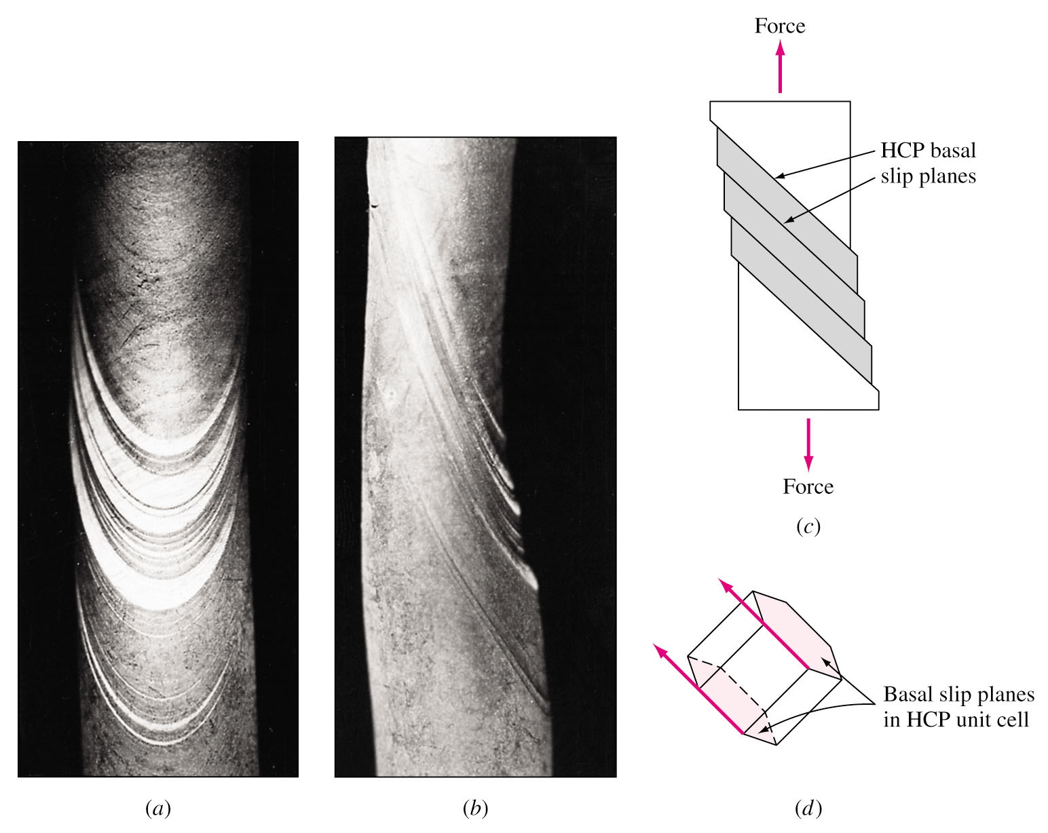
Plastic Deformation in Single Crystals
Plastic deformation (Zn) of single crystal results in step markings on surface slip bands. 滑移帶
Atoms on specific crystallographic planes (slip planes) slip to cause slip bands.
Slip is restricted primarily to slip on the HCP basal planes.
Slip bands

Slide 36
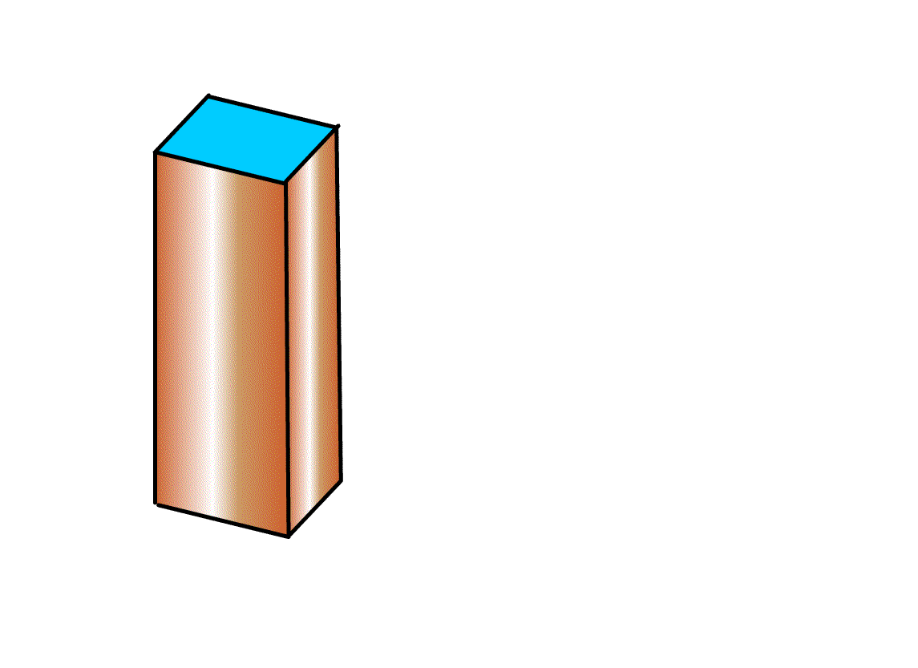
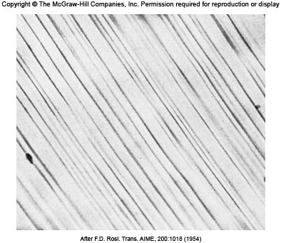
Slip Bands and Slip Planes
Slip bands in ductile metals (Cu, Al) are uniform. (Fig. 6.27) Slip occurs in many slip planes within slip bands.
Slip lines (offset by about 2000 Å) are about 50-500 atoms apart (~200 Å), where slip band are commonly separated by about 10000 atom diameters.
100×
Fig. 6.27 Slip bands of Cu single crystal after 0.9% deformation.

Slide 37
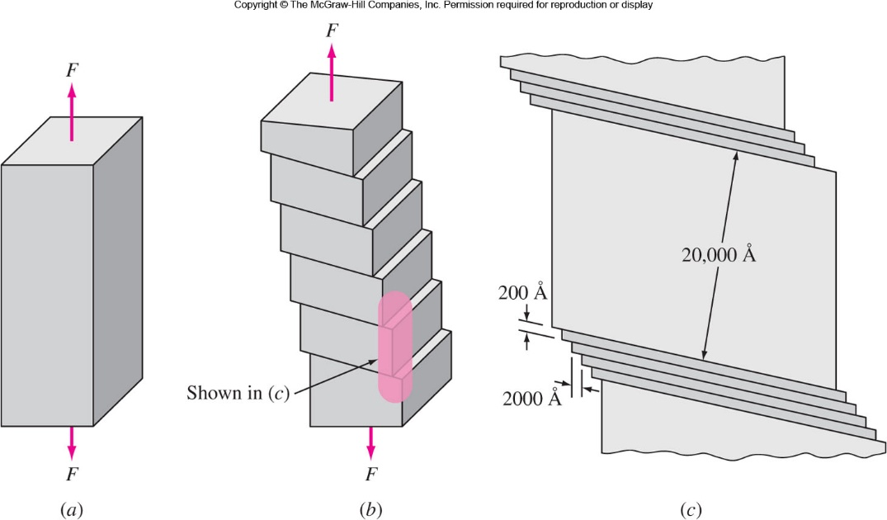

Slide 38
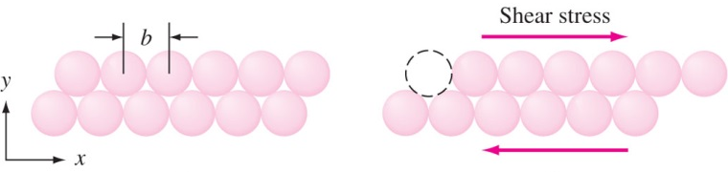
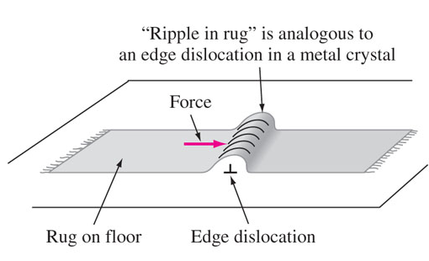
Slip Mechanism 滑移機制
Fig. 6.29
Fig. 6.29: Atomic model for the slippage of one block of atoms over another in a perfect metal crystal. The strength should be 1000-10000 times greater than their observed shear strength.
During shear, atoms do not slide over each other.
The slip occurs due to movement of dislocations likes “ripple in the rug” .

Slide 39
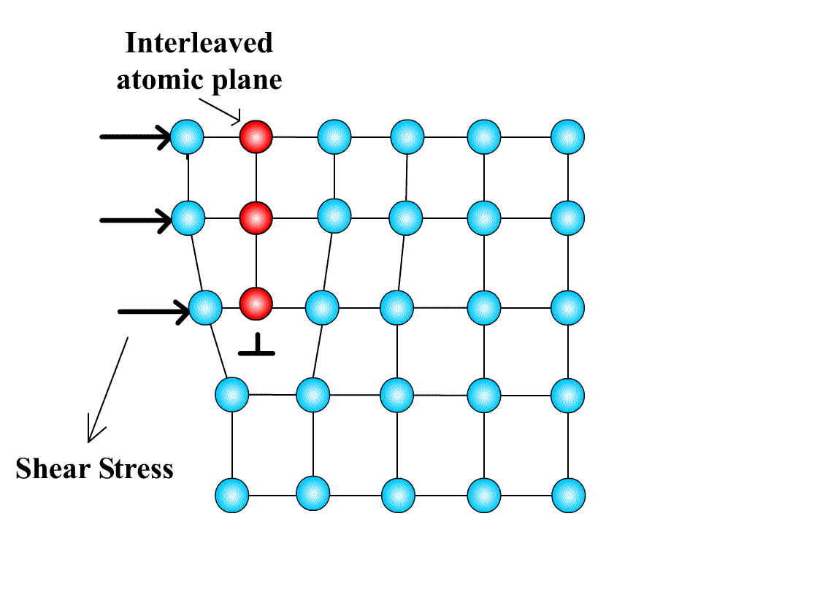
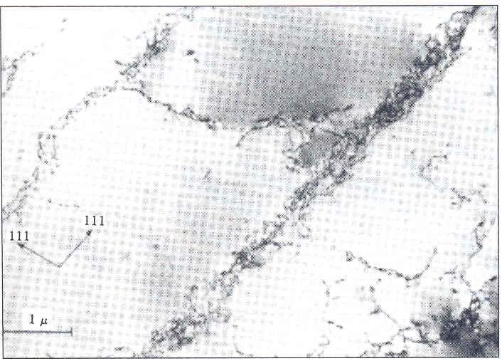
Slip Mechanism (Cont…)
High density of dislocations must be present. Solidified crystal: 10⁶ cm/cm³ (1/cm²), Highly deformed: 10¹² cm/cm³. Observed in TEM: Dislocations appear as lines.
Small stress → Dislocation move → Low shear strength
Wall of high dislocation density
Low disl. density
Dislocation cell structure in lightly
deformed Aluminum
Figure 6.30

Slide 40
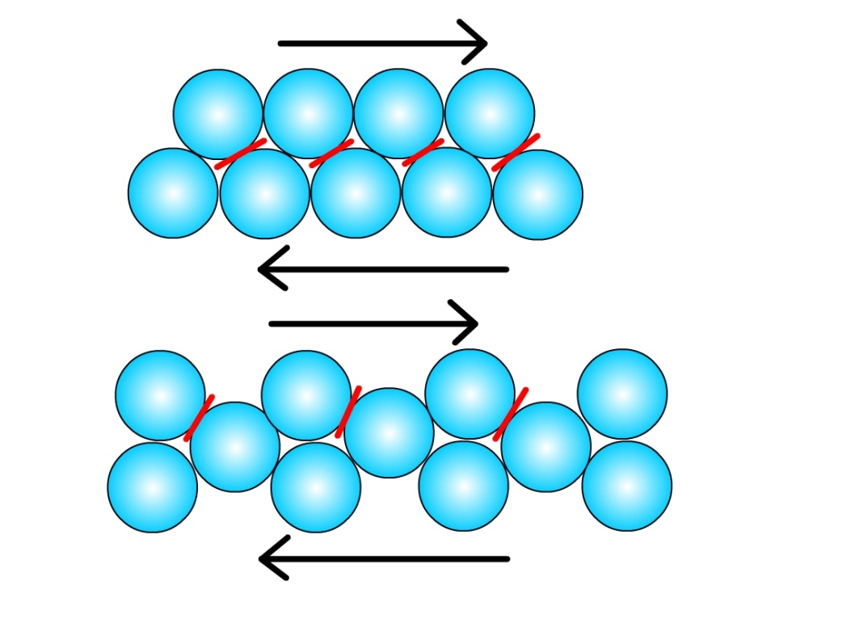
Slip in Crystals
Dislocations produce atomic displacements on specific slip planes and specific slip directions.
Slip occurs in densely or close packed planes.
Lower shear stress (less energy) is required for slip to occur in densely packed planes.
If slip is restricted in planes, then less dense planes become operative.
Slip in the close-packed directions is also favored since the atoms are closer together and less energy is required.
Close packed
plane
Non-close-packed
plane

Slide 41
Slip Systems 滑移系統
A combination of a slip plane and a slip direction is called a slip system.
Each crystal has a number of characteristic slip systems.
In FCC crystal, slip takes place in {111} octahedral planes and <110> directions.
4 {111} type planes and 3 <110> type directions. 4 × 3 = 12 slip systems.
BCC crystals are not close packed. The slip predominantly occurs in {110} planes ({112} and {123} also occur) that has highest atomic density. The slip direction is <111> type. 6 {110} and 2 <111> ⇒ 6 × 2 = 12 slip systems.
If HCP crystals have high c/a ratio, slip occurs along basal planes {0001}. For crystals with low c/a ratio, slip also occurs in {1010} and {1011} planes. The slip direction is <1120>.

Slide 42
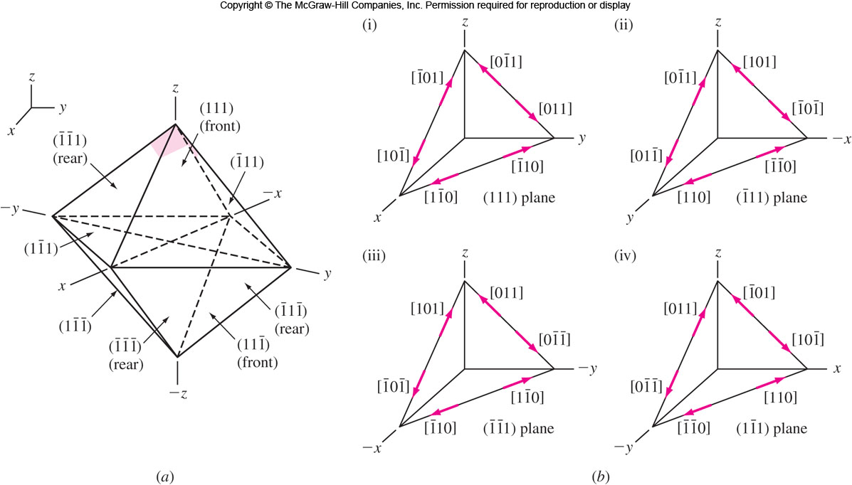
Slip Planes and Directions of FCC

Slide 43
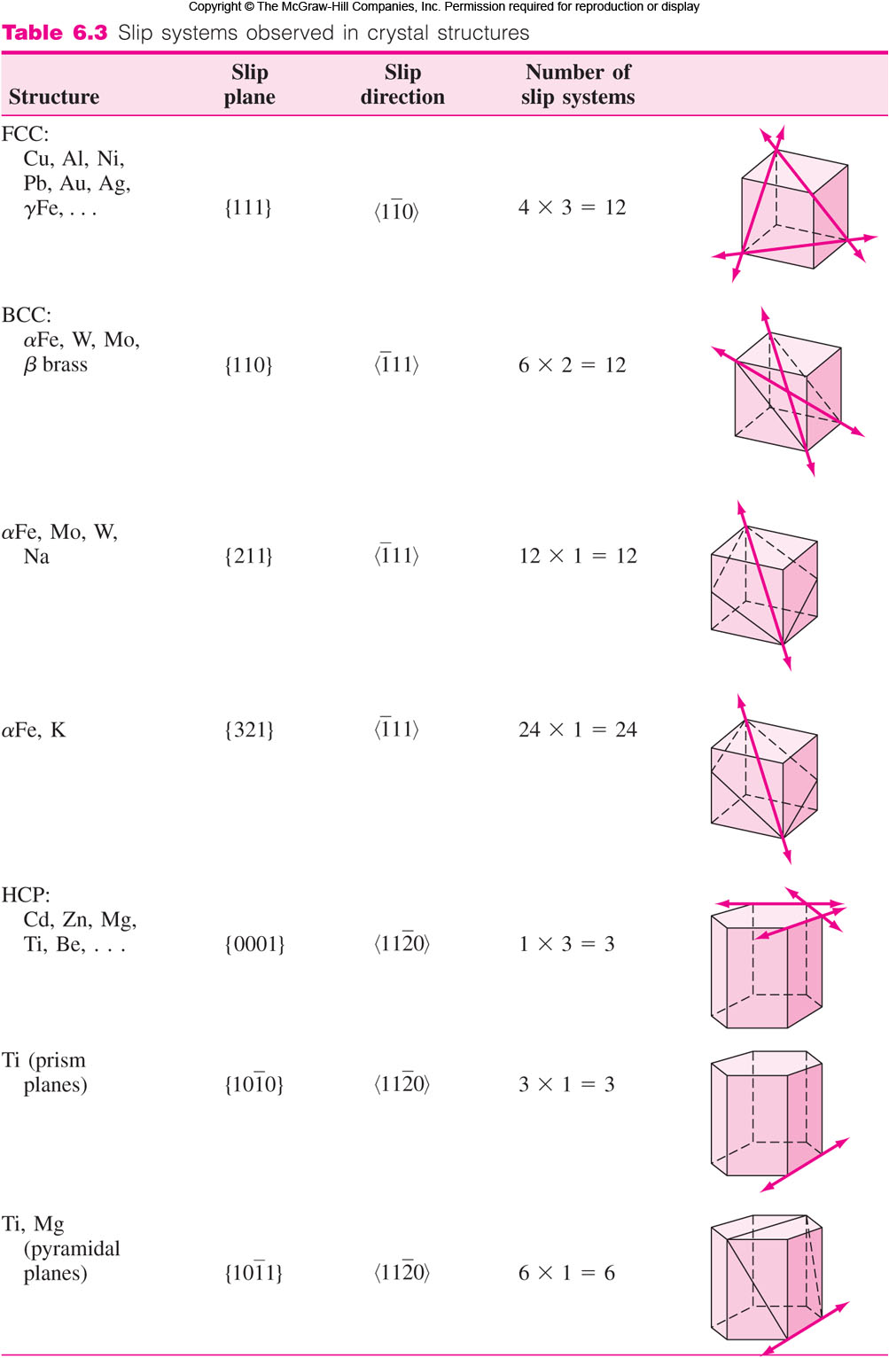
Slip Systems of FCC and BCC

Slide 44
Slip Systems of BCC and HCP
BCC

Slide 45
Critical Resolved Shear Stress 臨界分解剪應力
Critical resolved shear stress is the stress required to cause slip in pure metal single crystal.
Depends upon
Crystal Structure
Atomic bonding characteristics
Temperature
Orientation 方位 of slip planes relative to shear stress
Slip begins when the shear stress on the slip plane in the slip direction reaches critical resolved shear stress.
This is equivalent to yield stress.
Example: Zn HCP 99.999% pure 0.18 MPa
Ti HCP 99.99% pure 13.7 MPa
Ti HCP 99.9% pure 90.1 MPa

Slide 46
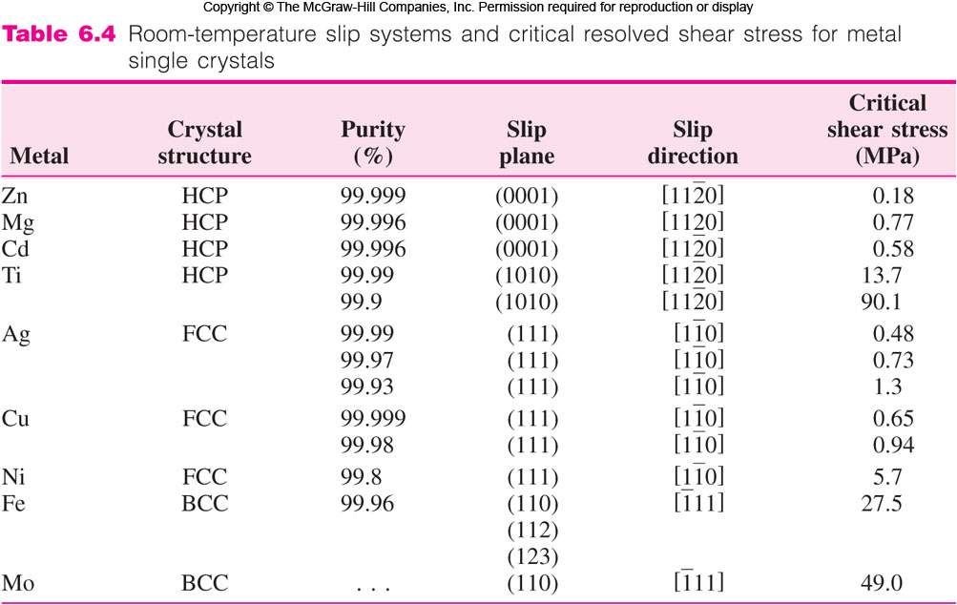
Slip Systems and CRSS

Slide 47
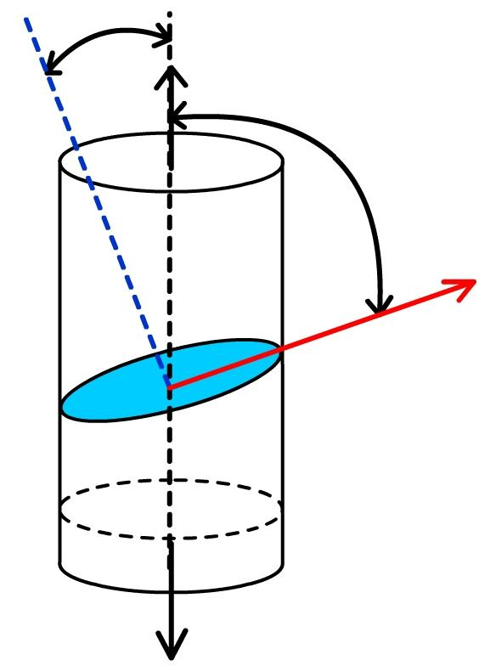
Schmid’s Law
The relationship between uniaxial stress action on a single cylinder of pure metal single crystal and resulting resolved shear stress produced on a slip system is give by Schmid’s law:
τ_{r} is maximum (0.5 σ) if λ = φ = 45°
Normal to
Slip plane
φ
Shear Force
τ_{r}=
Shear Area
Slip
direction
A₁ = Area of
slip plane

Slide 48
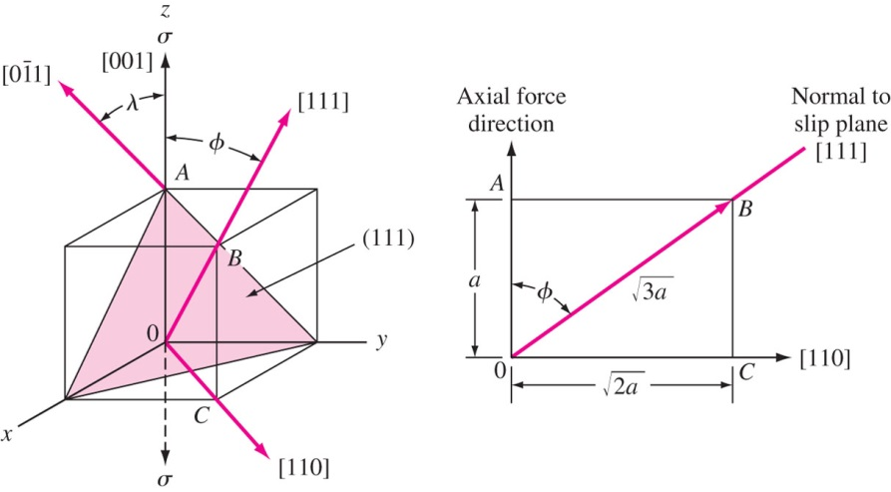
EP 6.9 Calculate the resolved shear stress on the slip system of a unit cell in an FCC nickel single crystal if a stress of 13.7 MPa is applied in the [001] direction of a unit cell.

Slide 49
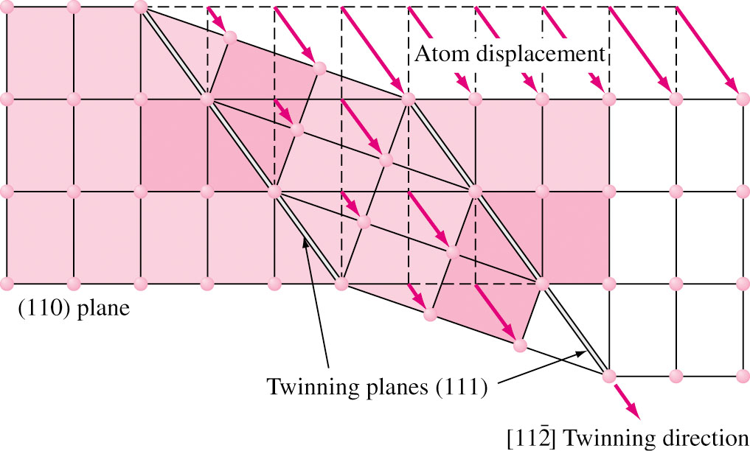
Twinning 雙晶
In twinning, a part of atomic lattice is deformed and forms mirror image of lattice next to it. Twinning plane is the interface between undeformed and deformed parts.

Slide 50

Twinning (Cont….)
Specific direction and plane in twinning is the same as slip.
Distance moved by atoms is proportional to their distance from twinning plane. This is different from that of slip.
Deformation from twinning is small.
Twinning reorients lattice and may place new slip systems.
Slip moves atom to a full length of atomic spacing and leaves a series of steps.
Twinning leaves well-defined deformed region

Slide 51

Twinning (Cont…)
Twining is the most important deformation in HCP crystals due to lesser slip planes. However, HCP metals are still less ductile than BCC and FCC metals.
At very low temperature or very high strain rate, twinning is found in BCC metals (Fe, Mo, W, Ta, Cr)
The FCC metals show the least tendency to form deformation twins. Only at extreme low temperature (4 K) and high stress level, copper can form deformation twins.
Deformation twins in titanium (99.77%)

Slide 52

Hall-Petch Equation
Finer the grains, superior are the mechanical properties (stronger, harder, tougher, strain hardening at room temperature).
More isotropic properties
Less resistant to corrosion and creep
Hall-Petch equation – Empirical
σ_{y} = σ_{o} + k/(d)^{1/2} σ_{y} = Yield strength
d = average grain diameter
σ_{o} and k are constants for a metal.
Does not apply to (1) extreme coarse or fine grains (2) at elevated temperature.
A similar effect exists between hardness and grain size.

Slide 53

Effects of Grain Boundaries on Strength
Grain boundaries stop dislocation movement and hence strengthen the metals. Except at high temperature.
Fine grain size is desirable, and hence metals are produced with finer grains.
Fig. 6.38 Stress-strain curve of single and polycrystalline copper. The polycrystal shows higher strength at all strains.
Dislocations cannot go directly from one grain to another in a straight line.
276 MPa
55 MPa
Fig. 6.38

Slide 54


Effects of Grain Boundaries on Deformation
Slip lines change directions at grain boundary.
Each grain has its own set of dislocations on its slip planes.
When dislocations encounter the grain boundary, their movement is terminated and form dislocation pileup. 堆積 ∴ Fine-grained materials process a higher strength.
Slip bands in polycrystalline
aluminum grains
Dislocations piled up against grain boundaries in stainless steel
54

Slide 55






Effects of Plastic Deformation
Plastic deformation results shearing of grains relative to each other.
The grains elongate in rolling direction.
Dislocations get rearranged.
Grain structure at
different regions of
cartridge brass
rolled into a wedge

Slide 56


Effects of Plastic Deformation (Cont..)
Dislocations form a cell structure with clear areas in the cell centers. For higher deformation, they become denser and elongated. Dislocations get rearranged.
50 μm
50 μm
Deformation structures of 30% and 50% cold-rolled unalloyed copper (OM).
胞室結構
0.5 μm
0.5 μm
Deformation structures of 30% and 50% cold-rolled unalloyed copper (TEM).

Slide 57

Effect of Cold Work on σ-ε Curves
Number of dislocations are increased by cold work.
Dislocation movements are hindered by other dislocations.
It become more and more difficult for the dislocations to move through the existing “forest of dislocations,” and thus the metal work or strain hardens with increased cold deformation.
Strain hardening: YS ↑, Hardness ↑, UTS ↑, Elongation ↓.
1018-Cold Rolled
1018-Annealed
Stress-Strain curves of 1018 steel
57

Slide 58

Effect of Cold Work on Tensile Properties
Strain hardening: YS ↑, Hardness ↑, UTS ↑, Elongation ↓.
Strain hardening is one of most important methods for streng-thening some metals.
Pure copper and aluminum can be strengthening signifi-cantly only by this method, e.g.: Cold-drawn unalloyed copper wires.
324 MPa
228 MPa
286 MPa
52%
9%
69 MPa
Fig. 6.43 Percent cold work versus tensile properties for unalloyed oxygen-free copper.

Slide 59

Solid Solution Strengthening 固溶強化
Solid solution strengthening: Addition of one or more metals can increase the strength of metals.
Solute atoms (substitutional or interstitial) create stress fields around themselves and hinder the dislocation movement and thus the solid solution become stronger than the pure metal.
Important factors in solid solution strengthening:
Relative-size factor: Differences in atomic sizes ↑ ⇒ Lattice distortion ↑ ⇒ Dislocation movement more difficult.
Quantity factor: % ↑ ⇒ YS ↑
Cu
Ref.: 劉國雄等，工程材料科學， 全華圖書，(2008) ，327 頁.

Slide 60

Solid Solution Strengthening (Cont..)
30% Cu Brass
UTS: 327 483 MPa
YS: 286 417 MPa
Elong: 9 13%
0% Cu Brass
UTS: 228 317 MPa
YS: 70 70 MPa
Elong: 52 70%
317 MPa
483 MPa
417 MPa
70%
13%
70 MPa
Fig. 6.44 Percent cold work versus tensile properties for 70Cu-30Zn brass.

Slide 61

Recovery and Recrystallization 回復與再結晶
Cold worked material has many dislocation and other defects and become hard and brittle.
Reheating, which increases ductility results in recovery, recrystallization and grain growth.
This is called annealing 退火 and changes material properties.
Conductivity

Slide 62





Cold Worked and Recovery Structure
Strain energy of cold work is stored as dislocations and point defects. Grains are greatly elongated in the rolling direction and dislocation cellular network are formed.
Recovery stage: Heating to recovery temperature relieves internal stresses. Polygonization 多邊形化 (formation of sub-grain structure) takes place. Dislocations are moved into lower energy configuration. The strength is reduced slightly but its conductivity is significantly increased.
Structure of 85%
cold worked 5657Al
TEM of 85%
cold worked 5657Al
Al-0.6~1.0%Mg
Polyganization
Dislocations
Slip bands
Grain Boundaries
次晶粒結構
Structure of stress
relived 5657Al
TEM of stress
relived 5657Al

Slide 63



Recrystallization
If metal is held at recrystallization temperature long enough, cold worked structure is completely replaced with recrystallized grain structure (new strain-free grain).
Two mechanisms of recrystallization:
Expansion of an isolated nucleus,
Migration of high-angle grain boundary.
More deformed
region
OM and TEM structure of recrystallized 5657Al
Expansion
Migration
High-angle grain boundary
Nucleus of
recrystallized grain
Figure 6.49

Slide 64

Effects on Mechanical Properties
Annealing decreases tensile strength and increases ductility.
Example (Fig. 6.50):
Factors affecting recrystallization:
Amount of prior deformation
Temperature
Time
Initial grain size
Composition of metal
520 MPa
85% Cu-15% Zn
50% cold
rolled
Annealed at
400 °C, 1 h
310 MPa
Tensile strength
520 MPa (75 ksi)
Ductility 3%
Tensile strength
310 MPa (45 ksi)
Ductility 38%
3%
38%
Figure 6.50
64

Slide 65

Facts About Recrystallization
A minimum amount of deformation is needed.
Smaller the deformation, higher the recrystallization temperature.
Higher the temperature, lesser is the time required.
Greater the degree of deformation, smaller are the recrystallized grains.
Larger the original grain size, greater amount deformation is required to produce equivalent recrystallization temperature.
Recrystallization temperature decreases with purity of metals.
Fig. 6.51 Continuous annealing

Slide 66

Recrystallization Dynamics
再結晶溫度
270 °C
Fig. 6.52 Time-temperature relations for the recrystallization of 99.0% Al cold-worked 75 percent.

Slide 67
Superplasticity in Metals
Superplasticity 超塑性 : At elevated temperature and slow loading, some alloys deform 2000%. At room temperature, it is 22% for steel.
Annealed Ti-6Al-4V alloy
Elongates 12% at room temperature
Elongates up to 1170% at 870 °C and 1.3 × 10⁻⁴/s loading rate.
Superplasticity conditions: * Very fine grain size (5-10 microns), * Highly strain-rate sensitive, * Temperature above 0.5 T_{m}, * Slow strain rate (0.01-0.0001/s).

Slide 68


Mechanism of Superplasticity
Very limited dislocation activity
Deformation mechanism:
Grain boundary sliding
Grain boundary diffusion
Sliding and rotation of individual grains.
Applications: Metal forming operations.
Blow forming produce automobile hoods. (Fig. 6.54)
Grains before and after deformation

Slide 69
Nanocrystalline Metals
Average grain diameter < 100 nm, nanostructure or nanocrystalline.
Grain size ↓ ⇒ harder, stronger (Hall-Petch equation), tougher, and Superplasticity.
If grain diameter reduces from 10 microns to 10 nm, yield strength of copper increases 31 times. Is this possible? How about ductility, toughness, fatigue, creep.
Very difficult to produce nanocrystalline metals.
If d < 5 nm, elastic modulus drops as more atoms are in grain boundary. This is opposed to that of microcrystalline.
Grain size from 1 μm to 10 nm ⇒ Hardness ↑ 4-6 times (Cu) or 6-8 times (Ni). However, Hall-Petch equation is invalid in lower nanocrystalline range.
Negative Hall-Petch effect might take place (< 30 nm).

Slide 70
Summary
Metal manufacturing methods: casting, rolling, forging, extruding, wire drawing, deep drawing.
Tensile test: elastic and plastic deformation, yield strength, ultimate tensile strength, elongation.
Hardness test: Brinell, Rockwell B and C, Vicker’s.
Plastic deformation: Slip system (slip plane + slip direction) number ↑ ⇒ more dutile.
Grain boundary: disl. moving barrier vs. grain sliding.
Grain size: Hall-Petch equation: σ_{y} = σ_{o} + k/(d)^{1/2} Fine grain ⇒ Strength ↑ , Superplastic.
Annealing: recovery, recrystlization, grain growth. Microstructure change ⇒ softening, ductility recovery.

